Slide 1
Computer Graphics
Computer Graphics concerns synthesis of pictures (images) of real or imaginary objects from their computer based models

Slide 2
Rendering
What is rendering?
The process of creating realistic images from models is called Rendering.
What is realistic image?
A picture that captures many of the effects of light interacting with real
physical objects.
Example of Realism is photographic realism. These pictures attempt to
synthesis the field of light intensities that would be focused on the film plane of camera.
Application of rendering?
Multi-media games
Architecture Model design
Walk-through simulation
Animation generation
Sports activity simulation

Slide 3
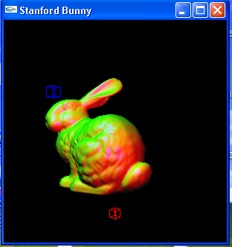

Slide 4
Modeling
The model is a description of Three dimensional objects in a strictly defined language or data structures. It would contain Geometry ,viewpoint, texture and lighting information
Two approaches
Surface Modeling : the surfaces that enclose an object define the shape of that object
Three representation of 3D surfaces
1) Polygon Mesh
When surfaces are planer then object is represented with Polygon mesh
2) Parametric bicubic Surface : used to represent curve surfaces
3) Quadric surface : used to represent objects like Sphere , Ellipsoid and Cylinder

Slide 5
Modeling
Solid Modeling : The object is defined as a solid mass often with density , weight and other attributes of a solid
In many engineering applications solid modeling is used because this approach makes certain information such as density , mass , inertia etc to the engineers e.g. simulating gear train it may be important to compute properties such as volume and center of mass.
It is useful in applications where it is important to distinguish between the inside, outside and surface of a 3D object and to compute properties of the object that depend on this distinction
In CAD/CAM solid modeling is useful where various operations are performed on the object before it is manufactured
It is useful in Applications where we may wish to determine whether two objects interfere with each other ; e.g. whether a robot arm will bump into objects in its environment or whether a cutting tool will cut only the material it is intended to remove.
A satisfactory representation for a solid object may even make it possible to generate instructions automatically for computer-controlled machine tools to create that object.

Slide 6
Solid modeling Techniques
Representation techniques should ensure that object is solid
Accurate , unambiguous and unique representation
1) Sweep : Sweeping an object along a trajectory through space defines a new object called a sweep
Translational or Rotational sweep
2) Boundary Representation
3)Constructive solid geometry (CSG) : Simple objects (primitives) are combined to create new solid objects by applying the set operations such as union, intersection and difference.
The CSG package provide primitive such as blocks, pyramids, cylinders, cones, spheres, etc. An object design with CSG is stored as a binary tree with operators at the internal nodes and primitives at the leaf nodes.

Slide 7
Maya the most widely used modeling tool
Scanners also give model of the 3D object
Model information can be saved in files. There are many formats in which the model information can be saved.
One open format called the VRML (Virtual Reality Modeling Language) format
e.g.
Vertices
0 0 0
1 0 0
1 1 0
0 1 0
faces
0,1,2,-1
2,3,0,-1

Slide 8
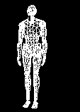

Slide 9
Rendering stages
Geometry
Projection
Visible Surface Determination
Illumination and Shading

Slide 10
More realism can be added
shadow effect,
texture mapping
light bounces from the neighboring surfaces along with the normal illumination of direct lights
(global illumination)

Slide 11
Rendering
Visible Surface determination or Hidden surface elimination Algorithms
Image Precision : which of n objects is visible at each pixel in the image
Object Precision : compare objects directly with each other, eliminate entire objects or portions of them that are not visible
Back Face Culling
Z-buffer
Painter’s Algorithm
Ray Tracing algorithm

Slide 12
Back face culling Algorithm
Object precision Algorithm
Remove back face
N.V <0 Visible
N.V>0 Back face

Slide 13
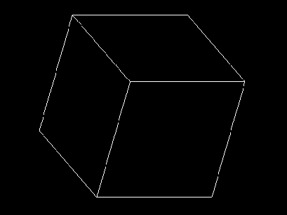
Back face culling

Slide 14
Z Buffer Algorithm
Image precision algorithm
Required Frame buffer and Z buffer
For(each polygon)
{
For( each pixel in polygon’s projection)
{
Pz=polygon’s z value at pixel coords(x,y)
If(pz>=Readz(x,y){
Writez(x,y,pz)
Writepixel(x,y,color at coords(x,y))}
}}

Slide 15
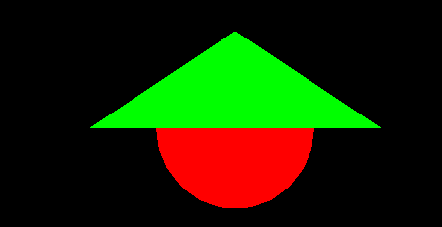

Slide 16
Ray Tracing
For(each scan line){
For(each pixel in scan line){
determine ray from centre of projection through pixel
for (each object in scene){
if (object intersect and closest considered so far)
record intersection and object
}
Set pixels color=closet object intersection
}}

Slide 17
Scan line algorithm
-Create Edge table
Each entry consists of
X value
Ymax
1/m
Polygon identification number
Polygon table
-coefficients of the plane equation
-color
in-out flag
Active edge table

Slide 18
Illumination and Shading
Achieving realism is to shade the visible surfaces based on the position ,orientation and characteristics of the surfaces and the light sources illuminating them
Thus we refer to the model for calculating the intensity at a single surface point as an illumination model or lighting model.
we refer to the procedure to obtain pixel intensities for all projected surface positions in a scene as surface rendering or surface shading.

Slide 19
Color of an object depends on the reflected light that our eye perceive
Reflected light depends on
Light source position and color
Surface characteristics
Viewing direction
e.g.
Surface that reflects only pure blue light is illuminated with pure red light appears black
Surface that reflect red is illuminated with white light appears red

Slide 20
Law of reflection
The angle of incident is equal to the angle of reflection
Diffuse and Specular Reflection
Smooth materials such as mirrors all the rays reflect and remain concentrated in the same bundle upon leveling the surface, causing the surface to have a shiny look. This type of reflection is known as specular reflection
Rough materials such as clothes , each individual rays meets a surface with a a different orientation. So they scatter in different directions. This type of reflection is known as diffuse reflection

Slide 21
Diffuse Reflection
L
N
It is also known as Lambert reflection
Diffuse illumination equation is
I=IpKdcos() 0<theta<90
Where Ip is light source’s intensity, Kd is material’s diffuse coefficient Kd and theta is angle between light source and normal to the surface at that point
I=IpKd(N.L) Assume N and L are normalized
When light incident on the surface >90 causes no light to be reflected and corresponding area appears black

Slide 22
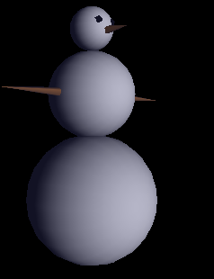

Slide 23

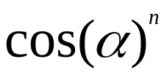
Specular Reflection
Specular reflection produces shiny highlights often seen on shiny objects like glass or metal
L
N
R
V
Specular reflection depends on
Surface normal N , Direction of light source L , Viewing direction V
Maximum specular reflection occurs when alpha is zero and falls sharply as alpha increases. This is approximated by
Whree n is material’s specular reflection exponenet. Values of n vary from 1 to several hundred
Smaller value indicates broad falloff while larger value indicates sharp falloff
i=IPks( )

Slide 24
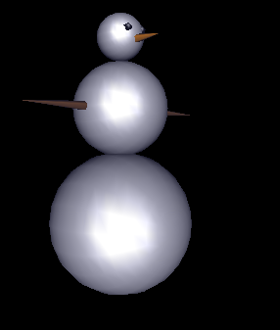

Slide 25
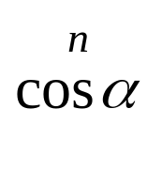


Phong illumination model
Ambient reflection : it impinges equally on all surfaces from all directions and is reflected by aconstant multiple
Diffuse reflection : reflected light depend on the angle between incident light and normal
Specular reflection : light is reflected in specific direction. it cause highlight on the surface
I=KaIa + fattIp[kdcos( ) +Ks ]

Slide 26
Shading Models
Flat shading models
Illumination equation is applied at one point and then entire surface is shaded with this color
It causes sudden transition in color from polygon to polygon
Smooth shading
Two methods
Gourad Shading : each vertex defines a normal vector. This normal is used to calculate the color at every vertex of the surface.
Then intensity is interpolated across surface
Phong Shading: each vertex defines a normal vector. Then normal is interpolated across surface. This normal is used to calculate the color at every point of the surface.

Slide 27
Comparision Between Gourad shading and Phong shading
Gourd abd phong both removes the faced appearance caused due to the intensity discontinuities associated with constant shading. But it suffers from Mach band effect
Phong shading produce more accurate results, because it finds normal at each point
Phong shading is computationally more intensive, since the interpolated normal must be normalized every time it is used in an illumination model

Slide 28
Comparision between Gouard and phong
If one vertex has highlight and other vertices have lower intensity, in case of gourad shading the intensity across the polygon is linearly interpolated between highlight intensity and the lower intensities , spreading the highlight over the polygon. In case of phong shading ,highlight is not spread.
If highlight fails to fall at a vertex, then gourad shading may miss it entirely since no interior point can be brighter than the brightest vertex from which it is interpolated
Both techniques render concave polygons incorrectly. Because it can give rise to a shading discontinuity.

Slide 29
Texture Mapping
Applying any shading models to planar or bicubic surfaces produces smooth , uniform surfaces. So we required variety of methods to simulate this missing surface detail
The fine detail on an object is generated using Texture mapping
When mapping an image onto an object , the color of the object at each pixel is modified by corresponding color from the image.the image is called a texture map
If the texture pattern is defined in an orthogonal coordinate system ( u,v) in texture space
Tthe surface in a second orthogonal coordinates system (x, y, z) , represented in parametric space (theta ,phi) ,
Adding the texture pattern to the surface involves determining or specifying a mapping function between the two space, e.g. the mapping from texture space to parametric space is
The mapping function is assumed to be linear
Theta = Au+ B phi = Cv + D
A, B ,C , D are obtained from the relationship between known points in the two coordinate systems

Slide 30
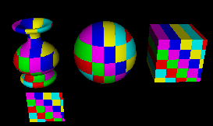

Slide 31
Shadow
The surfaces that are visible from the light source are not in shadow; those that are not visible from the light source are in shadow
The addition of shadows to the illumination equation
I=kaIa + ∑SifattIp[kd(N.Li) + Ks(Ri.V)n ]
Where Si = 0 if light i is blocked at this point
=1 if light I is not blocked at this point

Slide 32
Global illumination
An illumination model computes color at a point in terms of light directly emitted by light sources and of light that reaches the point after reflection from and transmission through its own and other surfaces.
It creates more realistic image

Slide 33



The Ray Tree
Recursive Ray Tracing
N₃
T₃
R₂
Viewpoint
N₂
T₁
R₃
R₁
L₁
L₂
N₁
L₃
L₁
R₁
T₁
L₂
L₃
Eye
N_{i} surface normal
R_{i} reflected ray
L_{i} shadow ray
T_{i} transmitted (refracted) ray
R₂
R₃
T₃

Slide 34
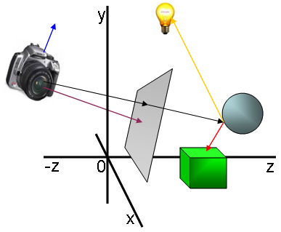

Slide 35
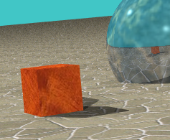

Slide 36
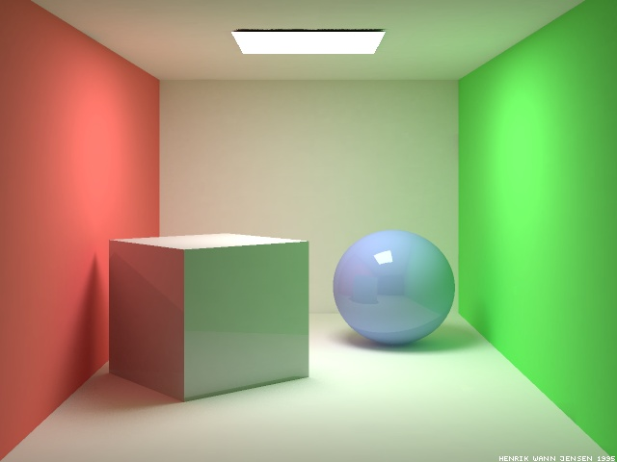
More Complex Light Paths

Slide 37
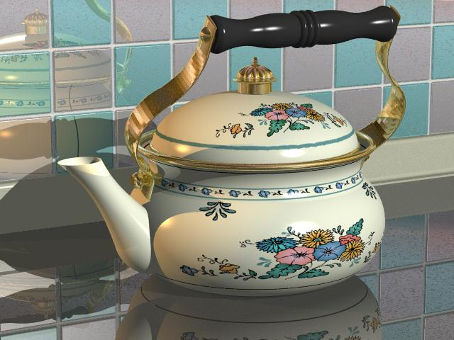

Slide 38
What is OpenGL ?
OpenGL is a software interface to graphics hardware. This interface consists of about 150 distinct commands that one can use to specify the objects and operations needed to produce interactive three dimensional applications.
OpenGL is designed to be independent of any window system or operating system
So it does not contains any commands for opening windows or reading events from the keyboard or mouse.
GLUT( OpenGL utility Toolkit) is used to develop graphics applications with opening a window, handle keyboard and mouse events

Slide 39
OpenGL commands use the prefix gl and initial capital letters for each word making up the command name
GLUT routines use glut prefix
Window management commands
glutInit(int *argc,char **argv) : initializes GLUT and processes any command line arguments
glutInitDisplayMode(GLUT_SINGLE|GLUT_RGB)
glutInitWIndowPosition(int x,int y) : position of upper-left corner of window
glutInitWindowSize(int width,int size)
glutCreateWindow(char *string) : create a window

Slide 40
Display callback
glutDispalyFunc(void(*func)(void):whenever
GLUT determines the contents of the window need to be redisplay , the callback function registered by glutDisplayFunc() is executed
Whenever program changes the contents of the window ,we have to call glutPostRedisplay(void) which gives glutMainLoop() a nudge to call the registered display callback.

Slide 41
OpenGL implementation
1 set up the camera (viewing transformation)
gluLookAt(position,direction,up vector)
2 arrange the object to desired position (modeling transformation)
glRotatef(), glTranslatef(),glScalef()
3 Choose a camera lens or adjust the zoom (projection transformation)
glOrtho(left ,right ,bottom, top,near,far)
gluPerspective(angle of field of view(fovy),aspect ratio(w/h),near ,far)
4 viewport transformation : determine how large you want the final image
glViewport(x,y,width,height)

Slide 42
Lighting
1 Define normal vectors for each vertex of all the objects
2 Create, select, position and enable one or more light sources
glLightfv(GL_LIGHT0,GL_POSITION,light_position) create light source
glEnable(GL_LIGHT0) enable light source
glEnable(GL_LIGHTING): enable lighting calculation
3 Create and select lighting model : define viewpoint position, global ambient light and lighting calculation on one side or two side
glLightModel()
4 Define material properities
glMaterialfv()

Slide 43
THANK YOU

